Slide 1


Text Summarizer
using T5 transformer

Slide 2
INDEX
Introduction
Dataset
Our Model
Results
Conclusion

Slide 3

INTRODUCTION
We have a lot of information or stories from around the world that we read in form of text, whether in newspapers, news articles, magazines, books, etc. in order to avoid lagging behind the others. But, it happens many times that we may want to gain this information within a relatively shorter span of time due to limited availability of time.
This demands some mechanism which can reduce the information size by removing the unnecessary or less important contents.

Slide 4

Introduction
One of the solution may be a text summarizer, that can take the text as an input and give out its summary as an output. There are many ways to devise a text summarizer in this Machine Learning era, but what has changed the recent trend is the advent of the transformers in ML and NLP models to make the task easier and more efficient.
After having this much information, we have implemented an NLP model of text summarizer, that makes use of the T5 transformer to summarize the input text.

Slide 5
Introduction
It is a powerful language processing model that works on encoder-decoder mechanism, pre-trained for both supervised and unsupervised learning. It converts all the NLP problems into a text-to-text format, and due to this reason, it gets its name: Text-to-Text Transfer Transformer (T5).
T5?

Slide 6

DATASET
The data for this research contains mainly news articles and their summaries. This file was chosen due to its availability and comprehensive nature, encompassing a wide range of news articles with corresponding summaries.
The data contains six columns: author, date, headlines, read_more, text, and ctext. However, we processed the data to retain only the text and ctext columns and removed unnecessary columns. These columns are then renamed to summary and text and we removed all the rows that containing missing values in either summary or text column.
The data set contains total of 4514 rows and 2 columns.

Slide 7

OUR MODEL
Our model is based on the T5 transformer, with the encoder and decoder blocks. T5 differs from other transformer based models like BERT and GPT on the blocks used. BERT and GPT uses either of the encoder or the decoder block, whereas the T5 model makes use of both the blocks. T5's ability to contextualize (which depends on self-attentional layers) and generate coherent summaries make it a better choice.
Encoder: The encoder block is concerned with taking in and comprehending the input text. In fact, it involves accessing embeddings for each input word/sentence (or token). An embedding is nothing but a point in semantic space.
Decoder: It takes the output embeddings from the encoder at each respective step and generates the final output with each subsequent step.

Slide 8
Our Model - T5 transformer
Our model being based on T5 transformer, is trained using teacher forcing, meaning that we always need an input sequence an desired output sequence during the training
First, the input text is tokenized and the tokens are then fed into the encoders which modifies them and forward it to the decoders.
We have seen that T5 uses both the encoder and decoder block, just like other CNN architectures. But there is a very fundamental difference - instead of the convolutional neural networks, T5 encoders and decoders have these three layers - feedforward, add & normalize and self-attention layers.

Slide 9
Our Model - T5 transformer
Let’s go a little deeper into what these terms mean and more importantly, what they do.
Self-attention determines how much a word is linked to other words in the sentence. This link is crucial to know how much a word is important in the word or sentence embedding. It is obvious that more self-attention weight matrices will enable the encoder to capture more range of dependencies.
Feedforward layers do two linear transformations separated by a non-linear activation function. The purpose of this layer is to add non-linearity to the model and to enable it to capture more complex patterns and links witthin the text.

Slide 10


Our Model - T5 transformer
Add and Normalize layer between each sublayer captures their output and adds them again to the input of the sublayers, leading to better performance of the model. After the addition has been done, layer normalization is done which normalizes the activation across the feature dimension. This ensure that input to each layer is mean-centred with unit variance.
This is also known skip connection layer!!

Slide 11
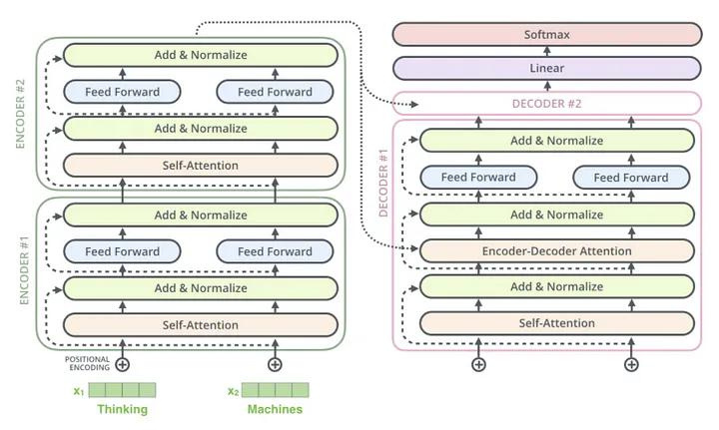
Our Model - T5 transformer
Overall working of the model
Encoding Block
Decoding Block

Slide 12
Our Model - T5 transformer
Overall working of the model
So, overall, our model first tokenizes the input, feeds these tokens into the encoders. The sublayers of feedforward, add & normalize and self-attention inside the encoders helps the model learn non-linearly.
Thus, after all the above processes, the encoder maps a continuous series of embeddings as an output which again goes into the decoder, passing through the same 3 sublayers.
At the end of the decoding process, both linear and Softmax activation functions are applied to make the output as much accurate as possible.
Also, note that the decoder outputs are constrained by the attentional vectors due to the self-attention sublayers

Slide 13
Our Model - Data Preprocessing
First of all, the data is split into training data and testing data using data split function of scikit learn library. This divides the dataframe df into two new ones - train_df (80%) and test df (20%).
Then we preprocessed the text and summary pairs using the T5Tokenizer for efficient training of text summarizing models.
We used separate a function to generate encoded representations of both the text and the summary.
Further, NewsSummaryDataset class was used to gain access and retrieve the individual datapoints, while preparing them in a format that is readily usable by the T5 model for training as well as evaluation.
Then we defined our model name with variable MODEL_NAME with value = t5-base.

Slide 14

Our Model - Training
We also initialised the tokenizer for our T5 model. These objects are essential components for subsequent stages of text summarization tasks, including data processing, training, and inference.
For the training, we have set:
N_EPOCHS = 10
BATCH_SIZE = 4
Then, we initialized the data_module to make the training efficient and controlled.
The next step involved initialising the model and defining how inputs will be processed and output will be given by it.
In the next step, we define how much the model will learn from each training batch and loss is calculated as the output of the training step.

Slide 15

Our Model - Validation, Test and Optimization
The next step is validation. The same thing is repeated as in training, but with new datasets. The output loss is calculated, which gives an idea about the efficiency of the model on new data.
The learning rate is set to 0.0001 and for optimization, AdamW optimizer is used. This is done in order to update model’s internal parameter during the training.
Then, we used functions to do
checkpointing to save the best performance of the model
logging to visualize the training process
Finally, with the help of the loading and freezing of the best model, we finalize the model to use it for the summarization task.
It is to be remembered that we have trained our model for extractive summarization, not abstractive one.

Slide 16
RESULTS
To determine the performance of our model, we use a measure called ROUGE score, where ROUGE stands for "Recall-Oriented Understudy for Gisting Evaluation." The main purpose of ROUGE scores is to measure how well a generated text (like a summary) matches a reference or a set of reference texts. It helps in assessing the quality of generated text by comparing it to human-generated reference texts.

Slide 17

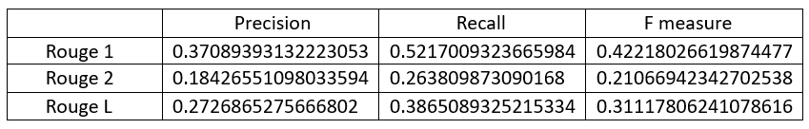
Results
Two of main types of ROUGE scores:
Rouge N: Measures how many sequences of n consecutive words (n-grams) in the generated text match those in the reference text. ROUGE N is further classified into many types, two of which are ROUGE 1 and ROUGE 2.
Rouge L: Examines the longest common subsequences of words between the generated and reference summaries.
Rouge N:
Rouge 1
Rouge 2
Rouge L

Slide 18
Conclusion
Extractive text summarization has a wide range of practical applications in various industries and fields. Here are some specific cases where it can be particularly useful:
News Summarization: Automatically generate short news summaries for websites, mobile apps, and social media platforms. This allows users to quickly grasp the key information without having to read the entire article.
Social Media Analysis: Analyze social media trends and sentiment by automatically summarizing and categorizing posts

